Slide 1
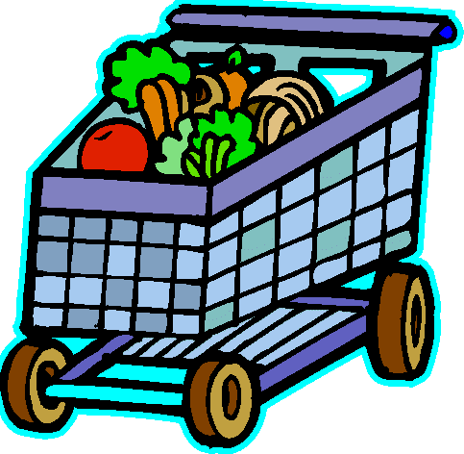
Transportation service
system
for
grocery kart
BY ----
Deepank Kartikey

Slide 2
Motivation of topic
Transportation is a major problem domain in logistics, and so it represents a substantial task in the activities of many companies.
In some market sectors, transportation means a high percentage of the value added to goods.

Slide 3
Therefore, the utilization of computerized methods for transportation often results in significant savings ranging from 5% to 20% in the total costs.
I am interested in providing optimum solutions to the above problem using GENETIC ALGORITHM.

Slide 4
Why genetic algorithm ?
Genetic Algorithm is based on the Darwin’s theory of
“SURVIVAL OF THE FITTEST!!!”
Genetic algorithms tend to thrive in an environment in which there is a very large set of candidate solutions and where the search space is uneven and has many hills and valleys.

Slide 5
Genetic algorithm (GA) is a search heuristic that mimics the process of natural evolution.
Genetic algorithms belong to the larger class of evolutionary algorithm (EA), which generate solutions to optimization problems using techniques inspired by natural evolution, such as selection, crossover and mutation.

Slide 6
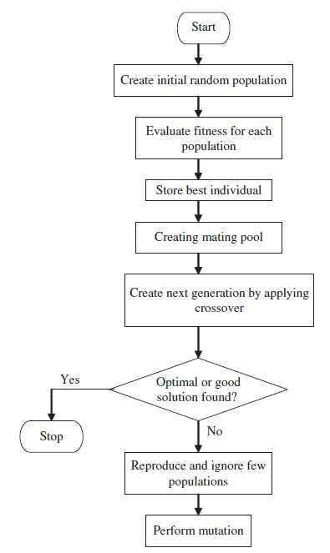
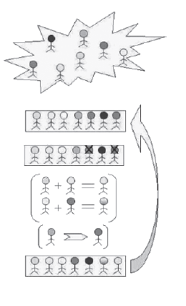

Slide 7
When to use Ga ?
Alternate solutions are too slow or overly complicated
Need an exploratory tool to examine new approaches
Problem is similar to one that has already been successfully solved by using a GA
Want to hybridize with an existing solution
Benefits of the GA technology meet key problem requirements

Slide 8
Ga IN tos..
From the varied scope of GA applications, one of the applications is “TOS” (Transportation Optimum Solutions).
The general scenario in the field of transportation presents many chances for several concrete definitions of subclasses of problems: determining the optimal number of vehicles, finding the shortest routes, etc.

Slide 9
All this subject to many restrictions like vehicle capacity, time windows for deliveries etc.
The basic problem we are discussing here consists in delivering goods to a set of customers with known demands through minimum-cost vehicle routes originating and terminating at the depot.

Slide 10
Problem statement
Grocery kart is responsible for supplying fresh vegetables to all the retail stores in Delhi. A fleet of old matador vans are used to haul the goods from the central warehouse in Rajouri Garden.
There are about 600 stores in their network.
Constraints on each van :

Slide 11
All the deliveries are to be made between 5AM to 8AM
Maximum number of stops are 20
Travelling distance not more than 65 km
Maximum load capacity is 1000 kg
At the end of the trip, each truck returns back to the central warehouse
Each stop at the store takes 5 min to download
Every km travelled takes 90 sec on an average

Slide 12
A new fleet of Mahindra vans are bought replacing the old matador vans in an effort to reduce costs and minimize green house emissions.
Maintaining each van costs Rs. 20000/month
The variable cost/km of travel is around Rs.30 for the first 3 years.

Slide 13
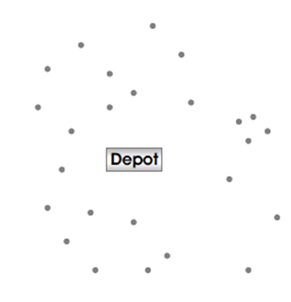
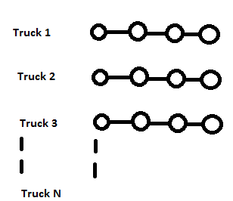
Store locations Central Warehouse
DEPOT
TOS
Using GA
OPTIMUM ROUTES

Slide 14
INPUT MODULE
OUTPUT MODULE
The distance between each store and the warehouse.
Daily demand for each store.
The number of trucks needed.
Routing of each truck.
Total miles travelled each day.
Total cost incurred.

Slide 15
Overall goals
Processing input data.
Compute the routing map on the basis of various factors given in the problem statement.
Profit, Cost and Efficiency analysis .

Slide 16
Generation of reports through comparative study of various cities and user data.
Comparative study of best solutions from evolved generations.

Slide 17
references
http://en.wikipedia.org/wiki/Genetic_algorithm
http://www.mu-sigma.com/muphoria/

Slide 18
THANK YOU

